Slide 1
OOPS CONCEPTS
CHAPTER - 10

Slide 2
Encapsulation

Slide 3
Encapsulation
Encapsulation is an information-hiding mechanism that makes code easy to maintain and understand.
Encapsulation, in object oriented programming methodology, prevents access to implementation details.
Properties offer a great way to encapsulate data fields along with any accompanying logic. Also, access modifiers such as private and public allow you to control the level of access for a class member or for the class itself.

Slide 4
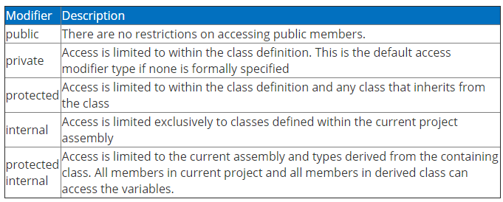
Access modifiers
Access modifiers are an integral part of object-oriented programming.
They support the concept of encapsulation, which promotes the idea of hiding functionality.
Access modifiers allow you to define who does or doesn't have access to certain features.

Slide 5
Private, public and protected access modifiers
private: limits the accessibility of a member to within the defined type. For example if a variable or a function is being created in a ClassA and declared as private then another ClassB can't access that.
public: has no limits, any members or types defined as public can be accessed within the class, assembly even outside the assembly. When C# code is compiled, the output executable code is contained within a .dll or an .exe file is also called as an assembly. An assembly is a unit of executable code that can be independently versioned and installed.
protected: plays a role only when inheritance is used. In other words any protected type or member becomes accessible when a child is inherited by the parent. In other cases (when no inheritance) protected members and types are not visible.

Slide 6
internal and protected internal access modifiers
The internal and protected internal access modifiers are sometimes useful when you work with class libraries or with solutions that have more than one project. To understand how they work, remember that when you build a project, all of the classes that make up the project are compiled into a single assembly.
Members that use the internal keyword alone are accessible to all of the classes within that assembly, but not to classes in other assemblies. Hence, if you have a C# project that has ClassA, ClassB and ClassC then any internal type and members will become accessible across the classes with in the assembly.
Similarly, members that specify protected internal are accessible to current class, derived classes that are a part of the same assembly, or derived classes in other assemblies.

Slide 7
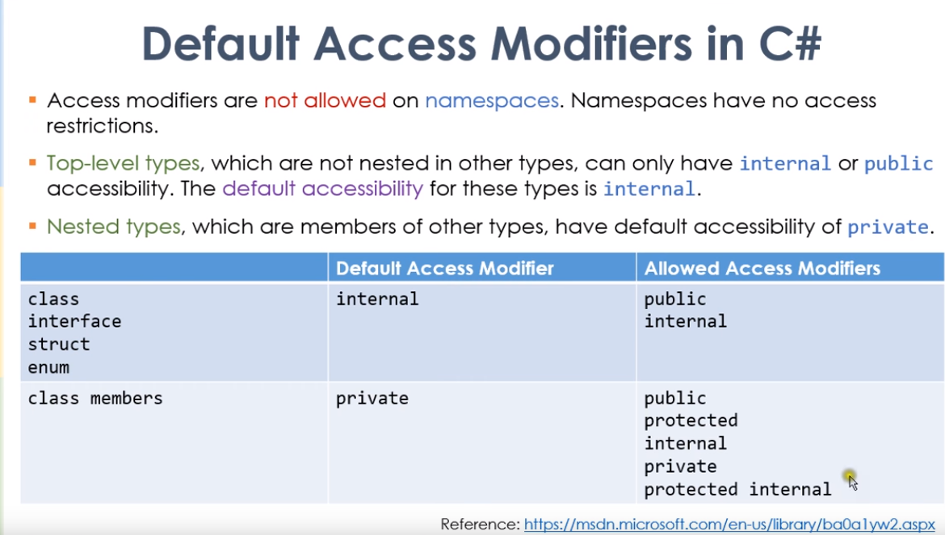
Notes:
https://www.youtube.com/watch?v=kxNO0lQ-YNs
https://www.youtube.com/watch?v=G-1jjwyQMlQ

Slide 8
Inheritance

Slide 9
Introduction to inheritance
Inheritance lets you create a new class based on an existing class. Then, the new class inherits the properties, methods, and other members of the existing class.
A class that inherits from an existing class is called a derived class, child class, or subclass. A class that another class inherits is called a base class, parent class, or superclass.
A derived class can extend the base class by adding new properties, methods, or other members to the base class. It can also replace a member from the base class with its own version of the member. Depending on how that's done, this is called hiding or overriding.
When you create a new form in C#, the form inherits the .NET Framework class named System.Windows.Forms.Form. As a result, all C# forms inherit the members defined by this base class. Then, as you add controls and code to the form, or extend the base class by creating new properties and methods.

Slide 11
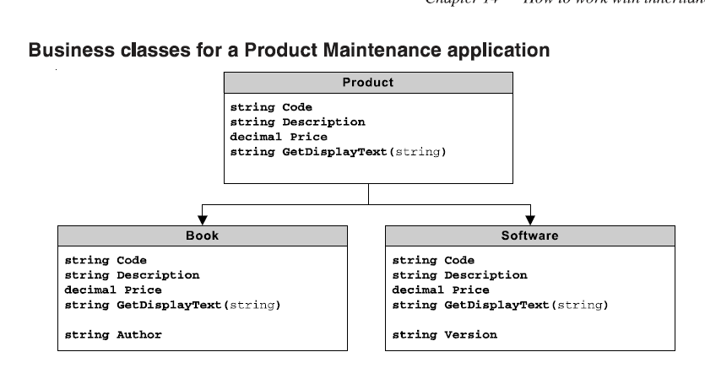
Using inheritance

Slide 12
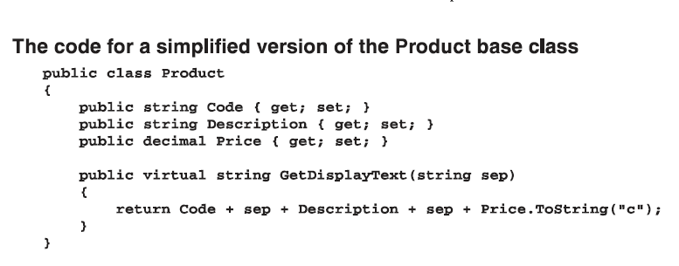
Defining the base class

Slide 13
Virtual keyword
The previous slide shows how to create a class that can be used as a base class for one or more derived classes. To start, you define the properties, methods, and other members of the class just as you would for any other class. Then, if you want a class that's derived from this class to be able to override one of the members of the base class, you include the virtual keyword on the declaration for that member.
The code shown in this figure, for example, uses the virtual keyword on the GetDisplayText method. Members that specify the virtual keyword are often called virtual members.
Notice that the Product class provides an implementation of the GetDisplayText method that returns a string containing the values for the Code, Description, and Price properties. If a derived class doesn't override the GetDisplayText method, that derived class will simply inherit the version implemented by this class.
As a result, creating a virtual member gives you the option of overriding the member in the derived class or allowing the derived class to defer to the version of the member defined by the base class.

Slide 14
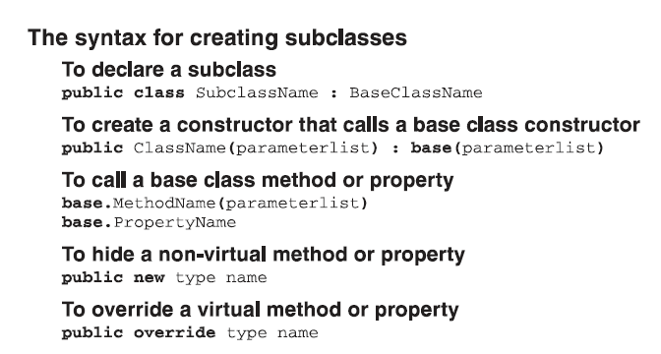
Creating a subclass

Slide 15
Creating a subclass
A constructor of a derived class automatically calls the default constructor of the base class before the derived class constructor executes. If you want to call a non-default base class constructor, you can specify the constructor to call when you declare the constructor of the derived class. Then, you can pass parameters to the base class constructor.
You use the base keyword to refer to a member of the base class.
You use the override keyword to override a virtual member of the base class. The override keyword replaces a base class member in a derived class.
You can use the new keyword to provide a new implementation for a non-virtual method or property of the base class. This is called hiding. The new keyword creates a new member of the same name in the derived class and hides the base class implementation.
But in most cases, it's better to use virtual and overridden methods and properties so you can benefit from polymorphism.

Slide 16
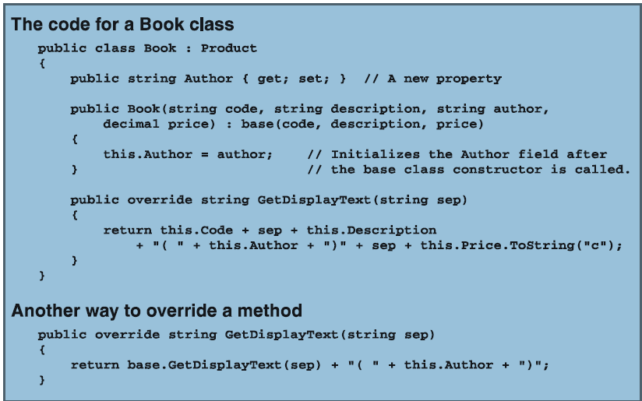

Slide 17
Code for the product, book and the software classes
The Product class, is the base class for the Book and Software classes. It's almost identical to the previous versions of the Product class that you saw in earlier. In fact, the only significant difference is that the GetDisplayText method specifies the virtual keyword. That way, this method can be overridden by the Book and Software classes.
The Book class, specifies the Product class as its base class. Then, it declares a private instance variable to hold the value of the Author property. This property is defined with get and set accessors that simply return the value of the instance variable and set the value of this variable to the value that's passed to the property.
The Book class provides two constructors. The first is an empty constructor that lets you create a new Book object with default values. The second constructor lets you specify the code, description, author, and price for a new Book object. This constructor calls the base constructor to initialize the Code, Description, and Price properties. As a result, the body of this constructor is just a single line of code that initializes the Author property.
The overridden GetDisplayText method for the Book class calls the base GetDisplayText method to get a string that includes the code, price, and description. Then, it adds the author's name in parentheses to the end of this string.
The Software class, shown in slide 20, is similar to the Book class, but it adds a property named Version. It too provides a constructor that calls the base constructor to initialize the Code, Description, and Price properties before it initializes the Version property. It also overrides the GetDisplayText method by calling the base GetDisplayText method and then adding the version information to the end of the string that's returned.

Slide 18
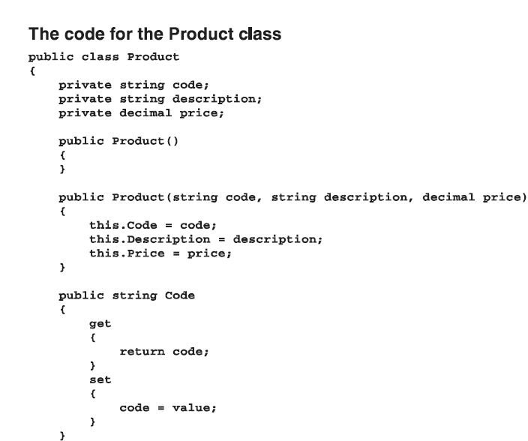

Slide 19
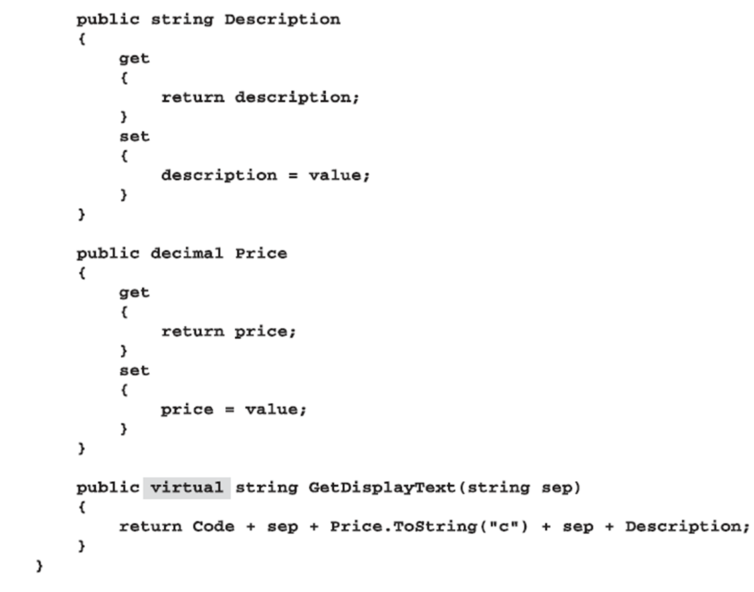

Slide 20
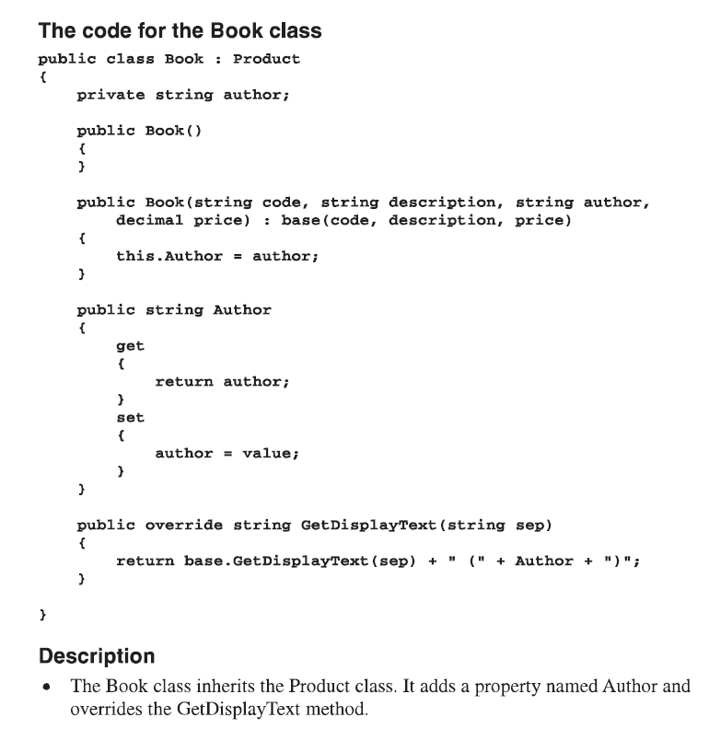

Slide 21
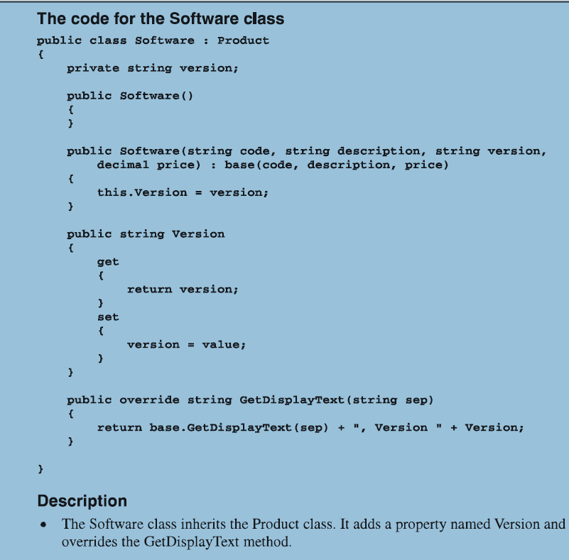

Slide 22
Polymorphism

Slide 23
Polymorphism
Polymorphism is the ability of derived classes to share common functionality with base classes but still define their own unique behaviour.
Polymorphism allows the objects of a derived class to be treated at runtime as objects of the base class.
If, for example, Book is a subclass of Product, you can treat a Book object as if it were a Product object.
When a method is invoked at runtime, its exact type is identified, and the appropriate method is invoked from the derived class.

Slide 24
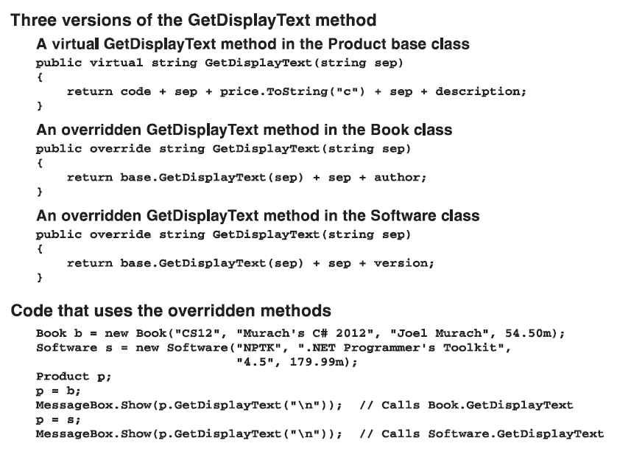

Slide 25
Object types and casting

Slide 26
Object types
Every object has a GetType method that returns a Type object that corresponds to the object's type.
You can use the properties of the Type class to obtain information about the type of any object, such as the type's name and the name of its base class.
The properties and methods shown in the next slide are only some of the more than 90 properties and methods of the Type class.
The easiest way to test an object’s type is to compare the Type object that’s returnd by the GetType method of the object with the Type object that’s returned by the typeof operator.
You can use the static GetType method to get a Type object for any class. This is useful when you want to check to see if an object is of a particular type.

Slide 27
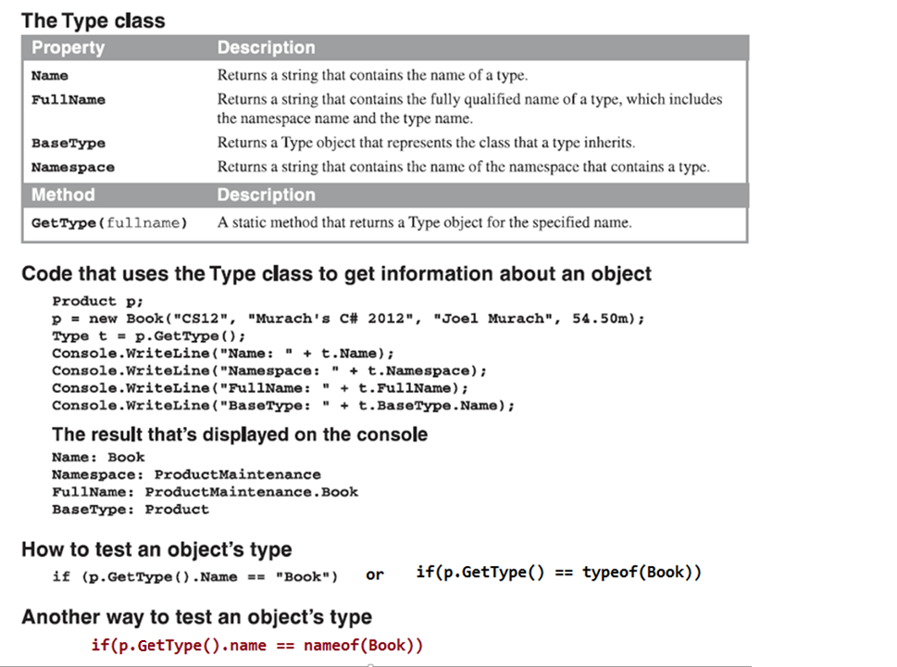

Slide 28
Using casting with inheritance
C# can implicitly cast a subclass to its base class. As a result, you can use a subclass whenever a reference to its base class is called for. For example, you can specify a Book object whenever a Product object is expected because Book is a subclass of Product.
You must explicitly cast a base class object when a reference to one of its subclasses is required. For example, you must explicitly cast a Product object to Book if a Book object is expected.
If you attempt to cast a base class object to a subclass, InvalidCastException will be thrown if the object is not of the correct type. For example, if you store a Software object in a variable of type Product and then try to cast the Product variable to a Book, a casting exception will be thrown.
You can use the as operator to cast an object to another type without throwing a casting exception if the cast is invalid. The as operator simply returns null if the cast is invalid.

Slide 29
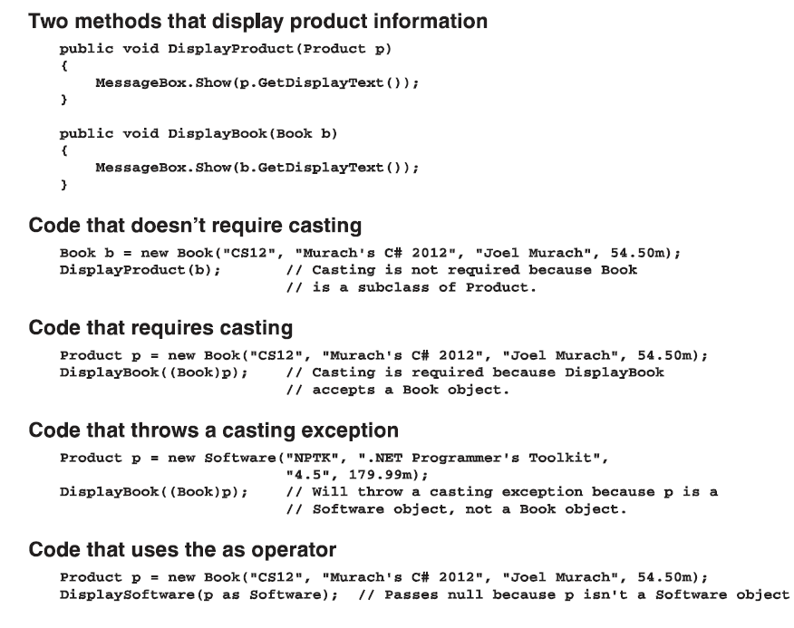

Slide 30
Abstract classes
An abstract class is a class that can be inherited by other classes but that you can't use to create an object.
To declare an abstract class, code the abstract keyword in the class declaration.
An abstract class can contain properties, methods, and other members just like other base classes. In addition, an abstract class can contain abstract methods and properties.
To create an abstract method, you code the abstract keyword in the method declaration and you omit the method body.

Slide 31
Abstract classes
To create an abstract property, you code the abstract keyword in the property declaration. Then, you code a get accessor, a set accessor, or both get and set accessors with no bodies.
Abstract methods and properties are implicitly virtual, and you can't code the virtual keyword on an abstract method or property.
When a subclass inherits an abstract class, all abstract methods and properties in the abstract class must be overridden in the subclass. The exception is if the subclass is also an abstract class.
An abstract class doesn't have to contain abstract methods or properties. However, any class that contains an abstract method or property must be declared as abstract.

Slide 32
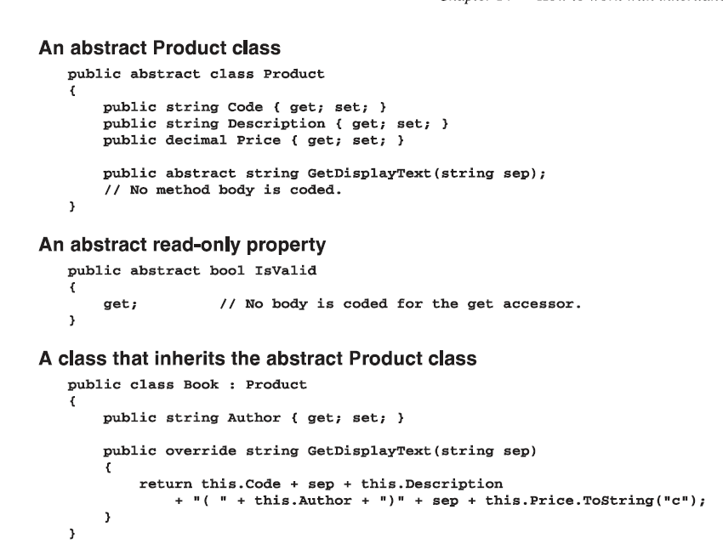

Slide 33
Sealed classes
A sealed class is a class that can't be inherited. (like final classes in java)
To create a sealed class, you code the sealed keyword in the class declaration.
You can also seal individual properties and methods. To create a sealed property or a sealed method, code the sealed keyword in the property or method declaration.
You can only seal a property or method if the property or method overrides a member of the base class. This allows you to create a virtual member in a base class, and then seal it in a derived class so that any subclasses derived from that class can't override the member. This feature is rarely used in business applications.

Slide 34
